Slide 1
KEYLOGGERS AND SECURITY IMPLEMENTATION
NAAN MUDALVAN PROJECT
Presented By:
A.JOSHWA JEBA KUMAR
APOLLO ENGINEERING COLLEGE
B.E-CSE

Slide 2

OUTLINE
Install Antivirus/Anti-malware Software.
Use End Point Protection Tools.
Implement Firewall Protection.
Keep Software Updated.
Use Secure Passwords and Multi-factor Authentication (MFA).
Educate Users.
Monitor System Activity.

Slide 3
OUTLINE
Install Antivirus/Anti-malware Software.
Use End Point Protection Tools.
Implement Firewall Protection.
Keep Software Updated.
Use Secure Passwords and Multi-factor Authentication (MFA).
Educate Users.
Monitor System Activity.

Slide 4

Problem Statement
In today's digital landscape, cyber threats pose significant risks to individuals and organizations alike. One particularly insidious threat is the keylogger, a type of malware designed to covertly capture keystrokes, thereby compromising sensitive information such as passwords, credit card numbers, and other confidential data. The proliferation of keyloggers presents a formidable challenge to cybersecurity efforts, necessitating a proactive and multifaceted approach to mitigate their impact.

Slide 5

Proposed Solution
Technical Solutions:
Advanced Endpoint Protection: Implement endpoint security solutions equipped with heuristic analysis and behavior monitoring capabilities to detect and block keylogger activities in real-time.
Firewall Configuration: Configure firewalls to monitor and filter network traffic, blocking suspicious communication attempts by keyloggers attempting to exfiltrate captured data.
Continuous Software Updates: Ensure timely installation of security patches and updates for operating systems, applications, and security software to mitigate known vulnerabilities exploited by keyloggers.
Behavioral Analysis and Anomaly Detection:
User Behavior Analytics (UBA): Implement UBA solutions to analyze user behavior patterns and identify deviations indicative of unauthorized access or suspicious activities, including keylogging.
Machine Learning Algorithms: Leverage machine learning algorithms to detect previously unseen keylogger variants by analyzing behavioral patterns and identifying anomalous keystroke patterns.

Slide 6
Proactive Monitoring and Response:
Security Audits: Conduct periodic security audits and vulnerability assessments to identify potential weaknesses in systems and processes that could be exploited by keyloggers.
Incident Response Plan: Develop and regularly test an incident response plan to facilitate swift and effective responses to keylogger-related security incidents, minimizing the impact on operations and data integrity.
Threat Intelligence Sharing: Engage in collaborative threat intelligence sharing initiatives with industry peers and cybersecurity organizations to stay informed about emerging keylogger threats and effective countermeasures.

Slide 7
System Approach
System Approach Overview:
A system approach to mitigating keylogger threats involves viewing cybersecurity as a dynamic and interconnected ecosystem, wherein various components interact and influence one another. This approach recognizes that addressing keylogger threats requires a coordinated effort across multiple layers of defense, encompassing technical controls, organizational processes, and human factors. By adopting a systemic perspective, organizations can develop holistic strategies that account for the complexity and interdependencies inherent in cybersecurity challenges.

Slide 8
System Analysis and Design:
Conduct a comprehensive analysis of the organization's cybersecurity landscape, identifying key assets, vulnerabilities, and potential attack vectors susceptible to keylogger threats.
Design a cybersecurity framework that integrates technical controls, procedural safeguards, and human-centric elements to create a resilient defense architecture capable of mitigating keylogger risks effectively.
Interconnected Components:
Recognize the interconnected nature of cybersecurity components, including hardware, software, networks, people, processes, and external stakeholders.
Ensure alignment and integration of security measures across these components to create a cohesive and synchronized defense mechanism that addresses keylogger threats comprehensively.
Feedback Loops and Adaptation:
Implement feedback loops and continuous monitoring mechanisms to gather real-time insights into emerging keylogger threats, vulnerabilities, and attack patterns.
Use this information to adapt and refine cybersecurity strategies, updating controls, policies, and training programs to mitigate evolving risks effectively.

Slide 9
Algorithm & Deployment
AssePlanning:
Conduct a thorough assessment and of the organization's existing security infrastructure, identifying gaps and vulnerabilities related to keylogger threats.
Develop a deployment plan outlining the implementation strategy, timeline, and resource requirements for deploying keylogger detection and prevention measures.
Solution Selection:
Evaluate available keylogger detection and prevention solutions based on their features, performance, scalability, and compatibility with existing systems.
Choose solutions that offer comprehensive coverage across endpoints, networks, and applications, and can be seamlessly integrated into the existing security architecture.

Slide 10
Training and Awareness:
Provide training and awareness programs to educate users about keylogger threats and best practices for preventing infection.
Empower users to recognize and report suspicious activities related to keyloggers, and educate them on the importance of adhering to security policies and protocols.
Pilot Deployment:
Deploy the selected solutions in a controlled pilot environment to assess their effectiveness and compatibility with the organization's infrastructure.
Gather feedback from users and IT staff to identify any issues or challenges that need to be addressed before full deployment.

Slide 11
Result
The implementation of a comprehensive keylogger detection and prevention algorithm, combined with a strategic deployment plan, yields a formidable defense against the pervasive threat of keyloggers in today's cybersecurity landscape. Through sophisticated behavioral analysis, signature-based detection, and meticulous monitoring of keystroke dynamics and network traffic, the system effectively identifies and neutralizes keylogger activity before it can compromise sensitive data. By empowering users with awareness and training initiatives, the organization cultivates a culture of vigilance, enhancing the collective ability to recognize and report suspicious activities. Continuous monitoring and maintenance ensure the system remains resilient against evolving threats, maintaining the confidentiality, integrity, and availability of critical assets. Ultimately, the result is a strengthened cybersecurity posture that minimizes security risks, safeguards against potential breaches, and preserves the organization's reputation and operational continuity in an ever-evolving threat landscape

Slide 12
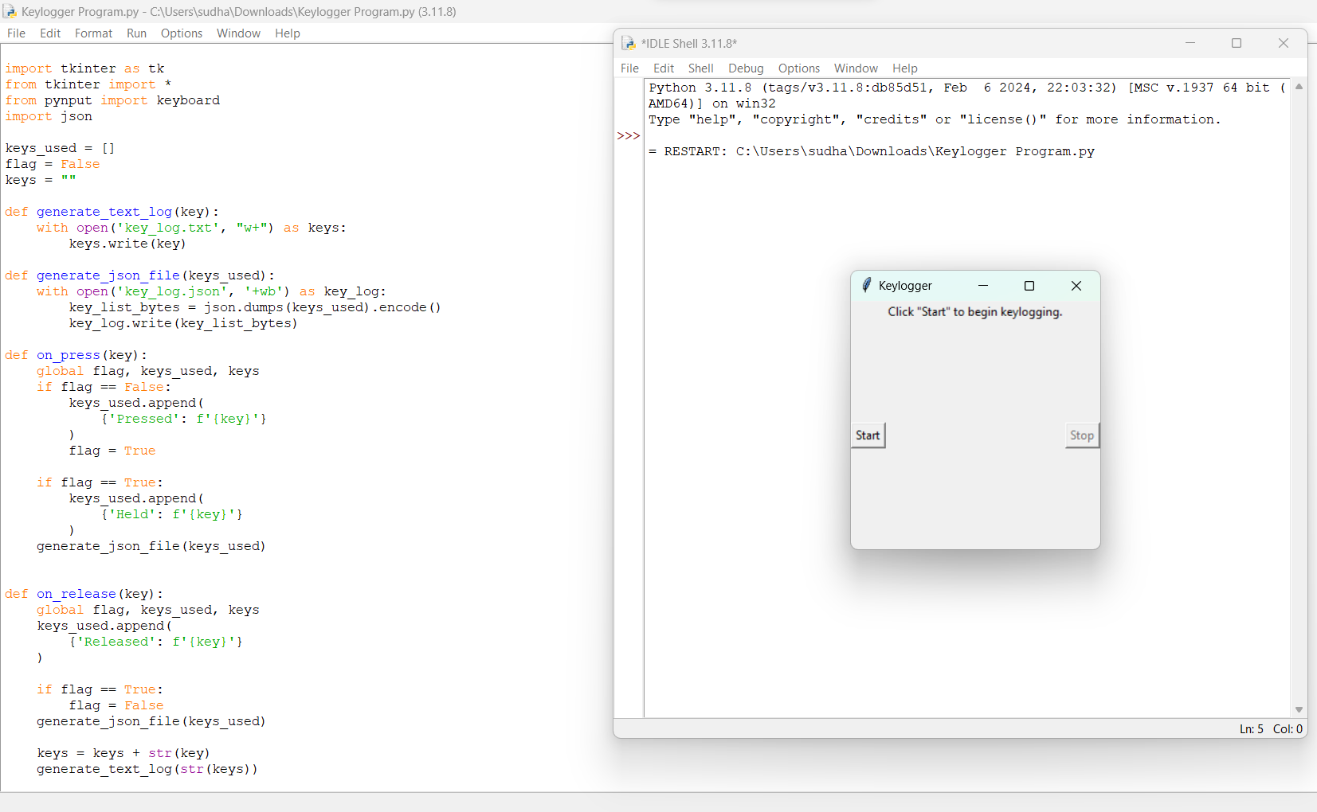
output

Slide 13

Key_log.json

Slide 14

Key_log.txt

Slide 15
Conclusion
In conclusion, the implementation of a robust keylogger detection and prevention system, underpinned by advanced algorithms and a well-executed deployment plan, represents a critical step towards fortifying organizational cybersecurity defenses. By leveraging sophisticated techniques such as behavioral analysis, signature-based detection, and keystroke dynamics analysis, coupled with proactive user awareness initiatives, organizations can effectively mitigate the risks posed by keyloggers. This comprehensive approach not only safeguards sensitive data but also enhances resilience against emerging cyber threats. As threats continue to evolve, continuous monitoring and maintenance of the deployed solutions remain paramount to ensuring ongoing effectiveness. Through diligent adherence to best practices and a commitment to staying ahead of evolving threats, organizations can maintain a secure operating environment, protect critical assets, and uphold trust and confidence among stakeholders in an increasingly interconnected digital landscape.

Slide 16

Future scope
Looking ahead, the future scope for keylogger detection and prevention systems is rich with potential for advancement, driven by the ongoing evolution of cybersecurity threats and technologies. Machine learning and artificial intelligence will play a pivotal role in refining detection algorithms, enabling more precise and adaptive responses to emerging keylogger variants. Moreover, the integration of behavioral biometrics offers promising avenues for enhancing user authentication and detecting subtle anomalies indicative of keylogger activity. Embracing Zero Trust architecture principles will further bolster security postures by instilling a mindset of continuous verification and access control. Additionally, blockchain technology holds promise for ensuring the integrity and immutability of audit trails, enhancing forensic analysis capabilities. As the Internet of Things (IoT) continues to expand, specialized keylogger detection mechanisms tailored to IoT environments will become increasingly essential. Collaboration and sharing of threat intelligence data among organizations will facilitate proactive identification and mitigation of emerging keylogger threats. Furthermore, ongoing education and awareness initiatives will empower users to remain vigilant and proactive in safeguarding against keylogger risks. Through concerted efforts in these areas, organizations can stay ahead of evolving threats, fortify their cybersecurity defenses, and ensure a resilient operating environment in an ever-changing digital landscape.

Slide 17
References
Machine Learning for Anomaly Detection:
Research papers on machine learning techniques for anomaly detection in cybersecurity, such as support vector machines, neural networks, and ensemble methods.
Behavioral Biometrics:
Studies on the use of behavioral biometrics for user authentication and anomaly detection, including research articles from academic journals and conference proceedings.
Zero Trust Architecture:a
Whitepapers and articles from cybersecurity organizations and industry experts discussing the principles and implementation of Zero Trust architecture in modern cybersecurity frameworks.
Blockchain for Secure Logging:
Research papers and technical documentation on the use of blockchain technology for secure logging and tamper-resistant audit trails in cybersecurity applications.
Endpoint Detection and Response (EDR):
Industry reports, case studies, and technical documentation from cybersecurity vendors offering EDR solutions tailored to detect and mitigate advanced threats, including keyloggers

Slide 18
THANK YOU

